Slide 1
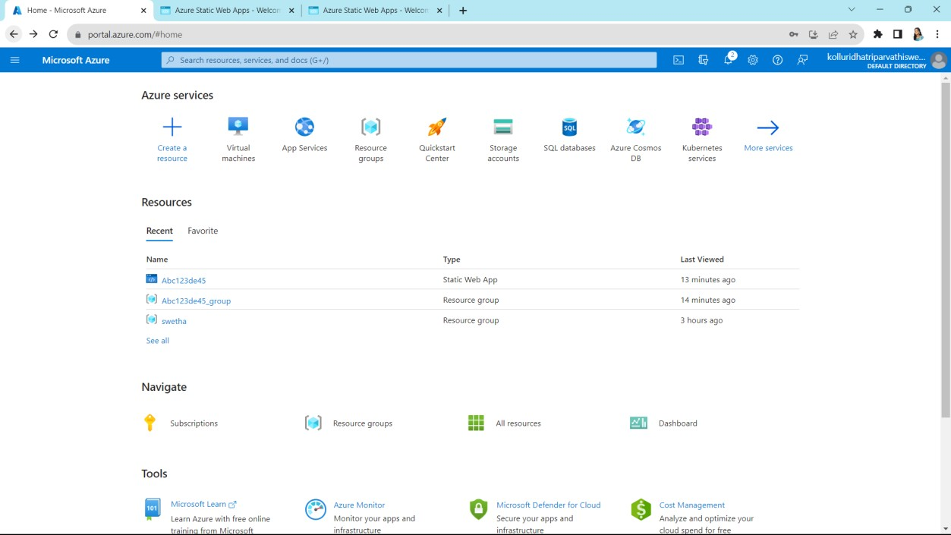
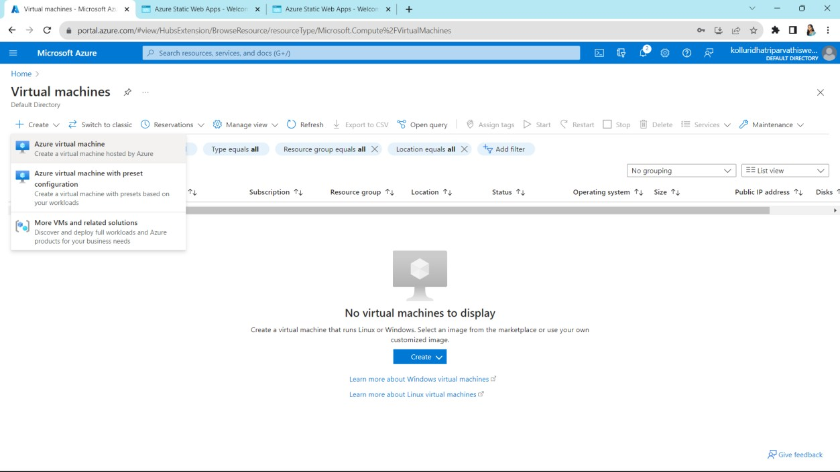
EXPERIMENT 13
Demonstrate Infrastructure as a Service (IaaS) by establishing the remote connection, launch the created VM image and run in your desktop.first we can sign in into Azure
Select virtual machine to create a virtual machine
Click on create

Slide 2
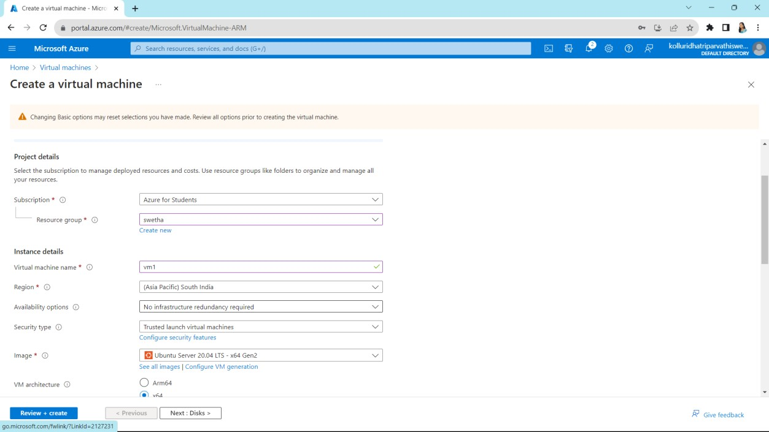
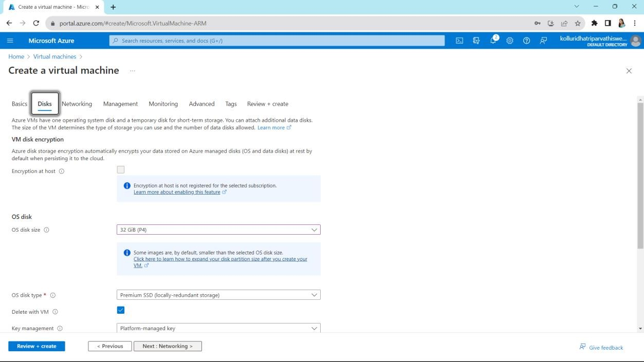
Fill up the given requirements
Change the disc size and click on next

Slide 3
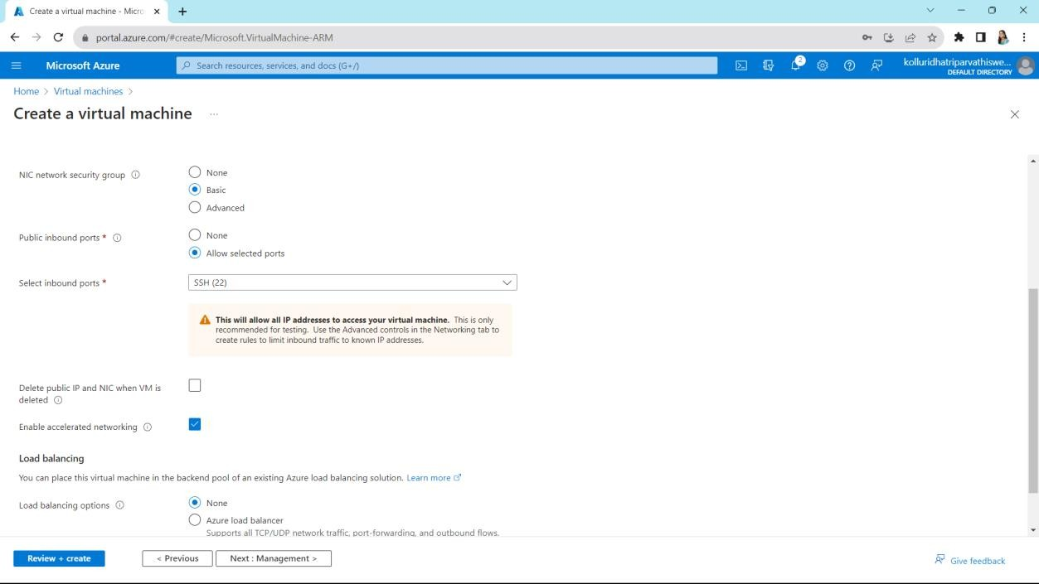
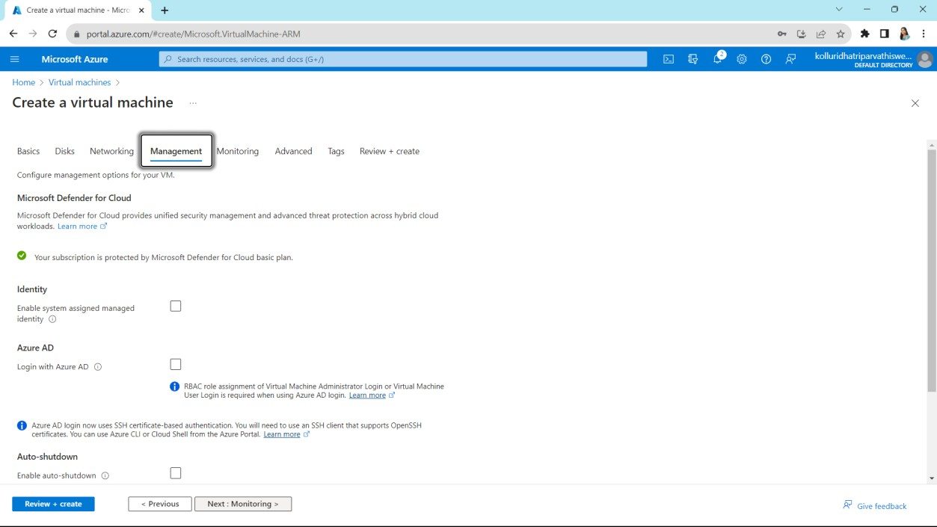
Click on next
Click on next

Slide 4
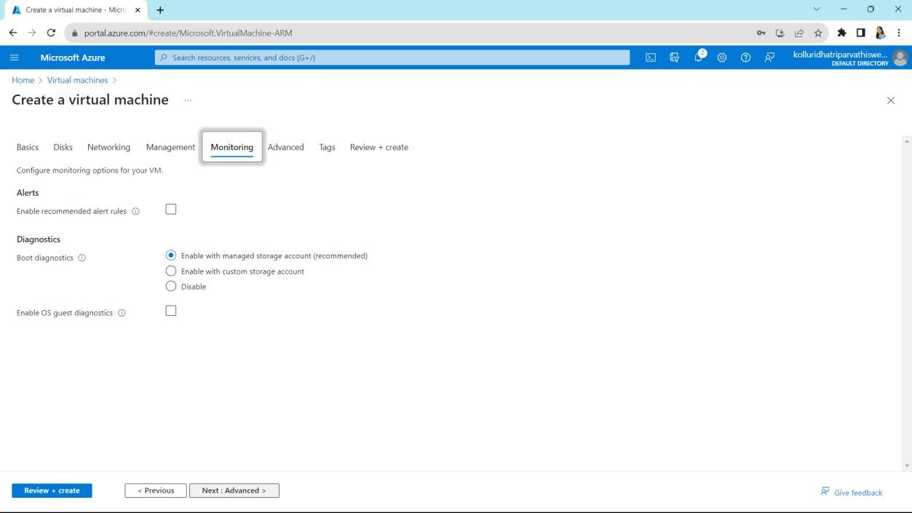
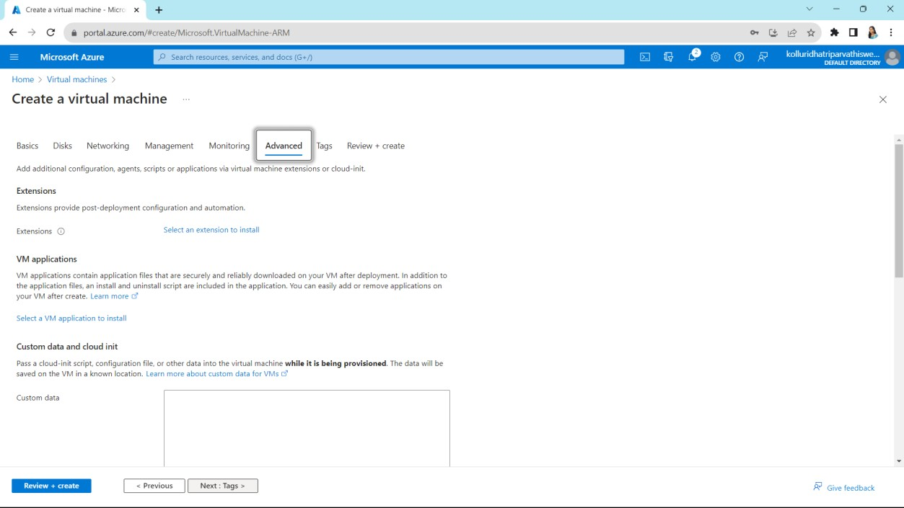
Click on next
Click on next

Slide 5
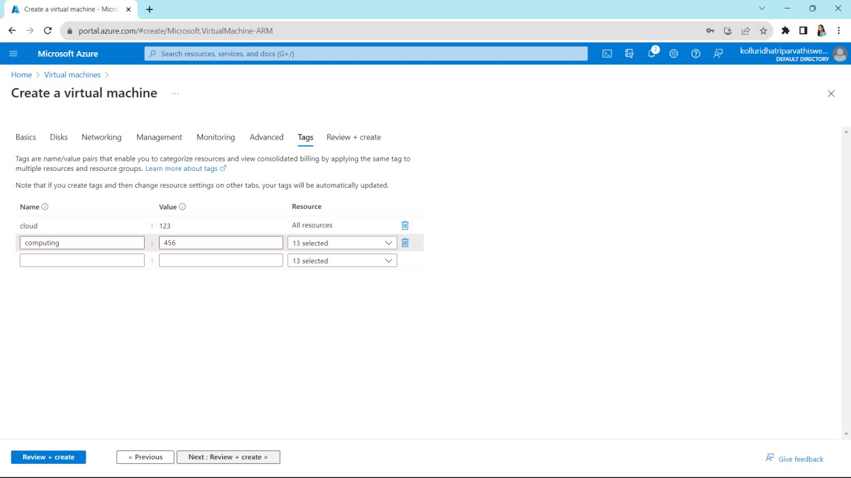
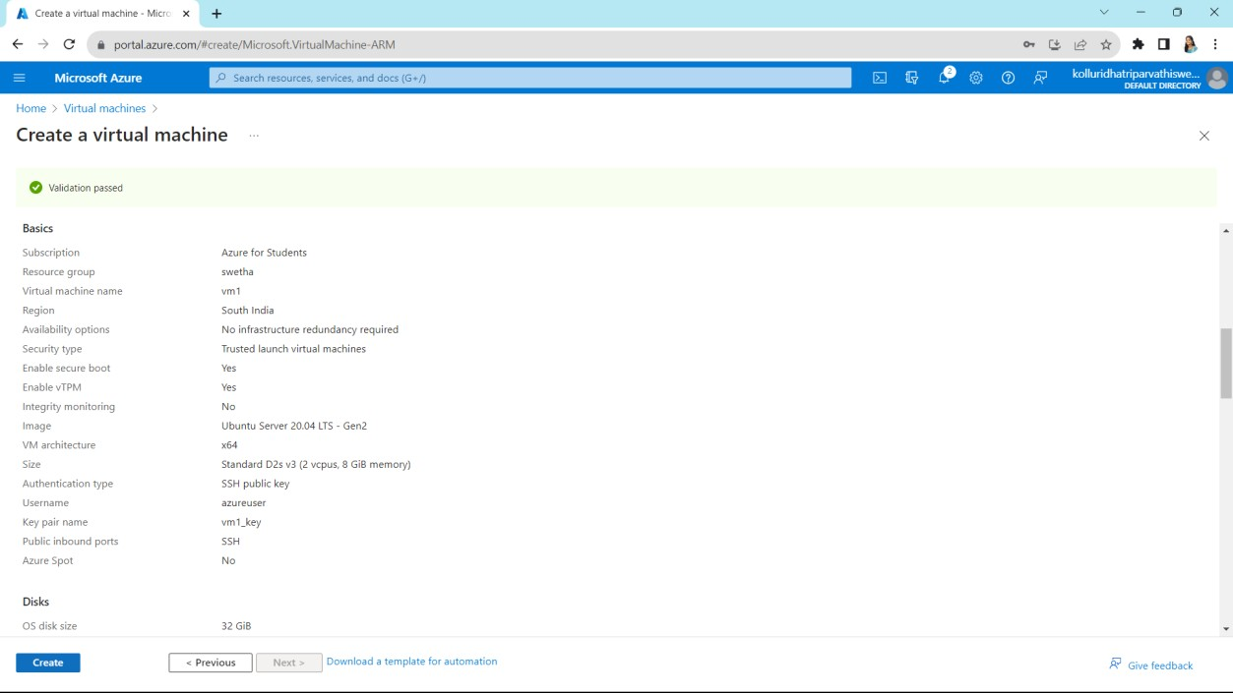
Give some names and values and click on next
It shows our summary

Slide 6
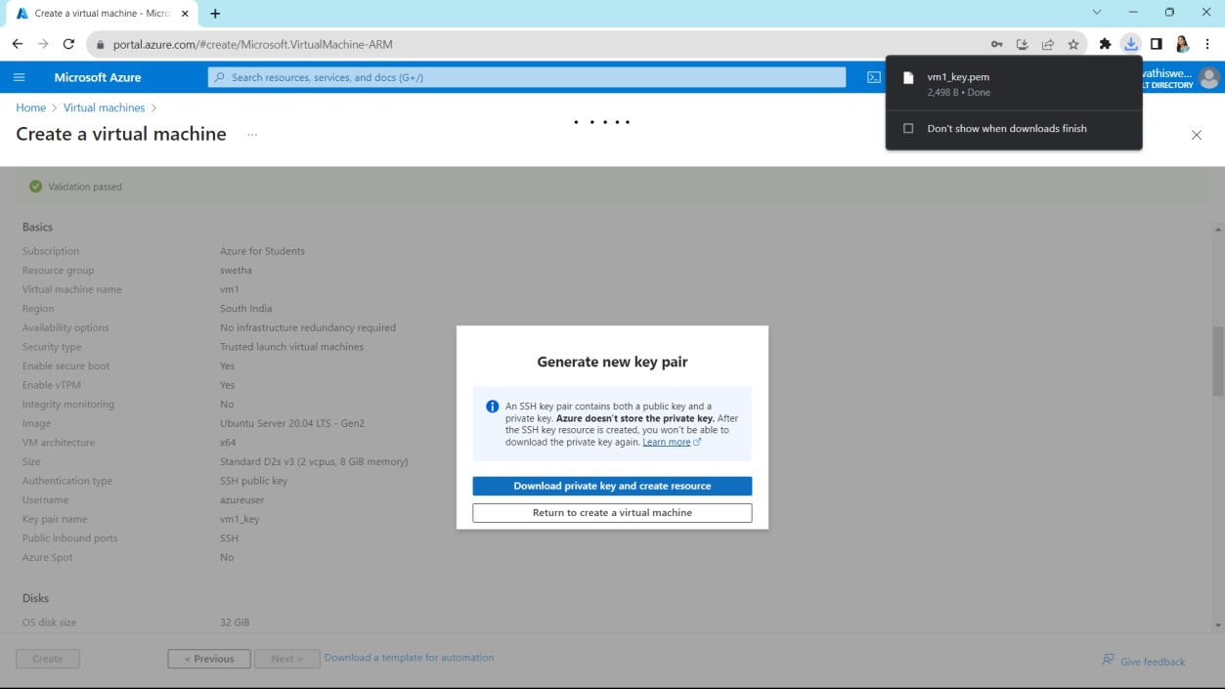
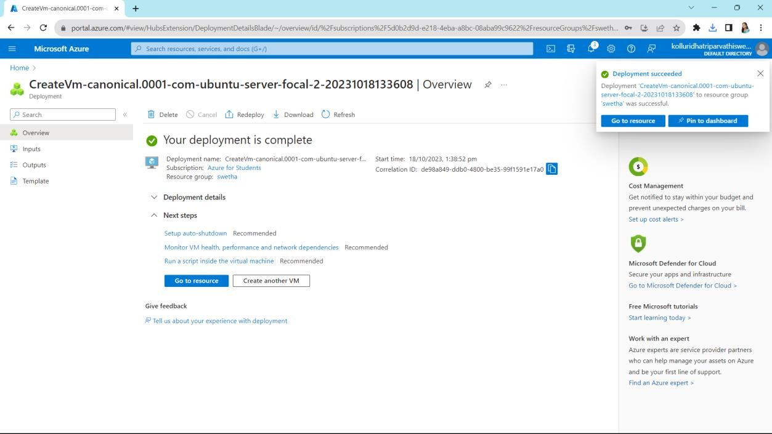
Click on create and it asks to download click on download
Our required virtual machine is created

Slide 7
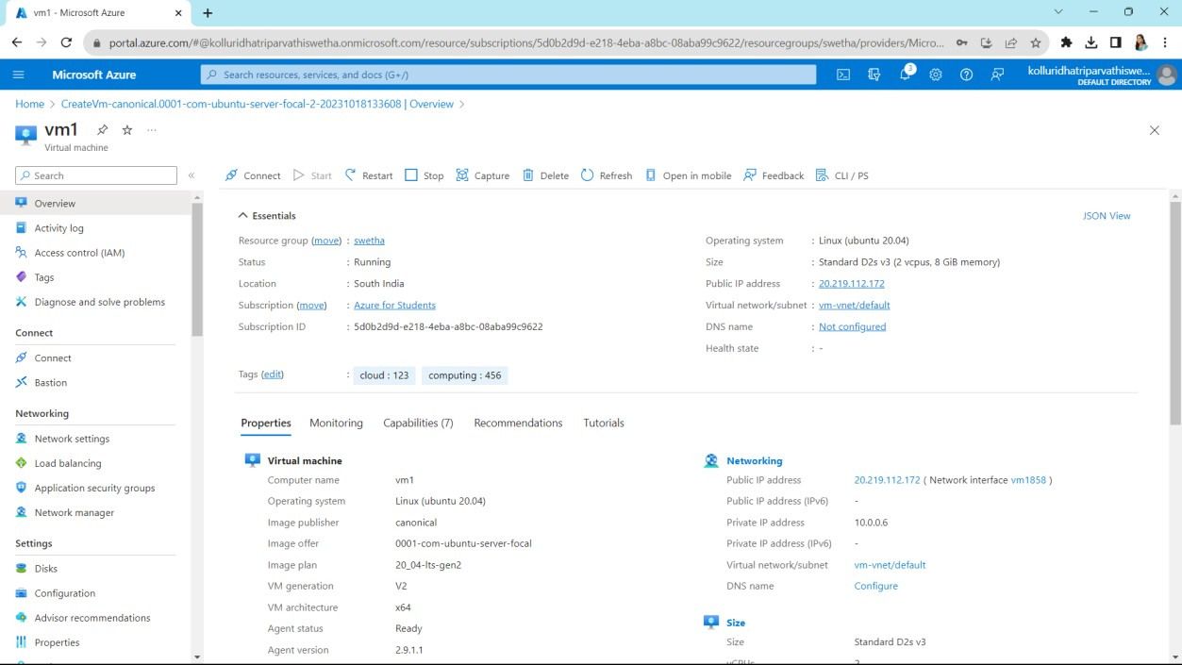
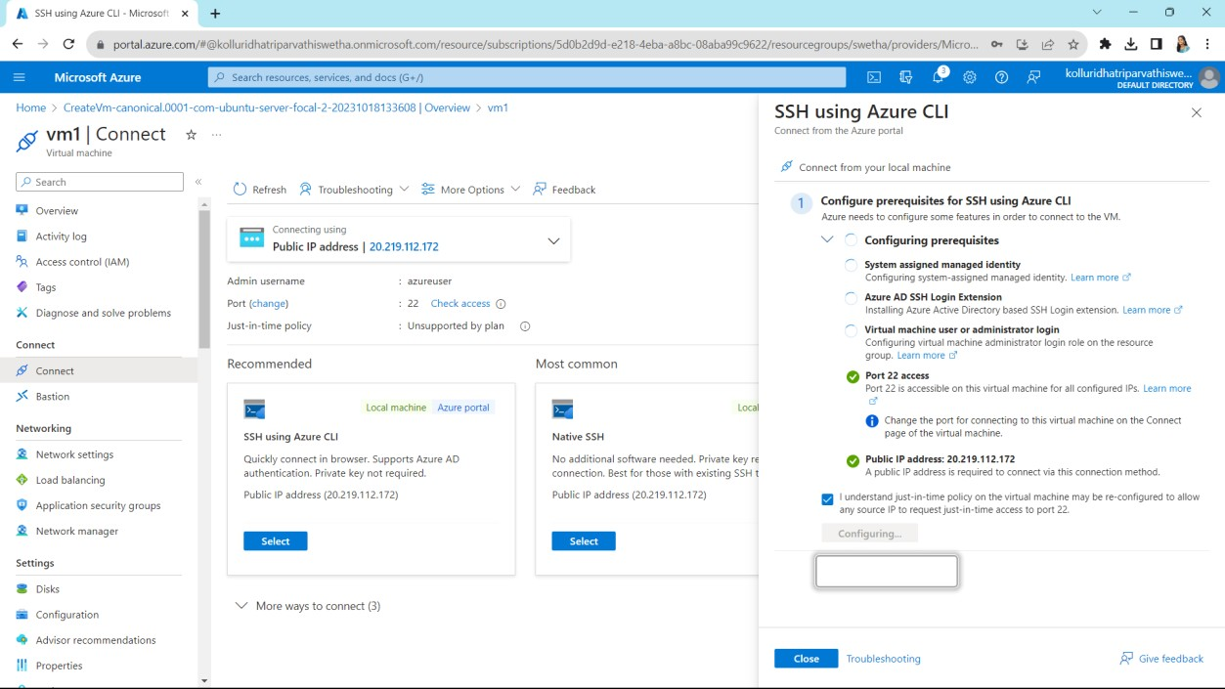
Click on connect
It will loaded and appears like this
And then close

Slide 8
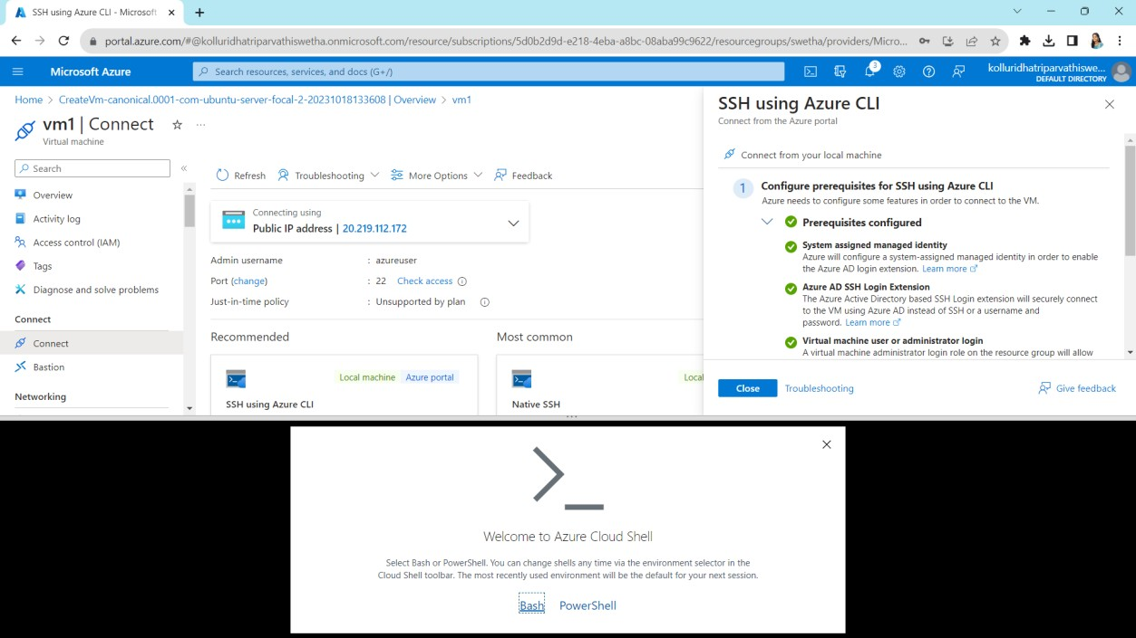
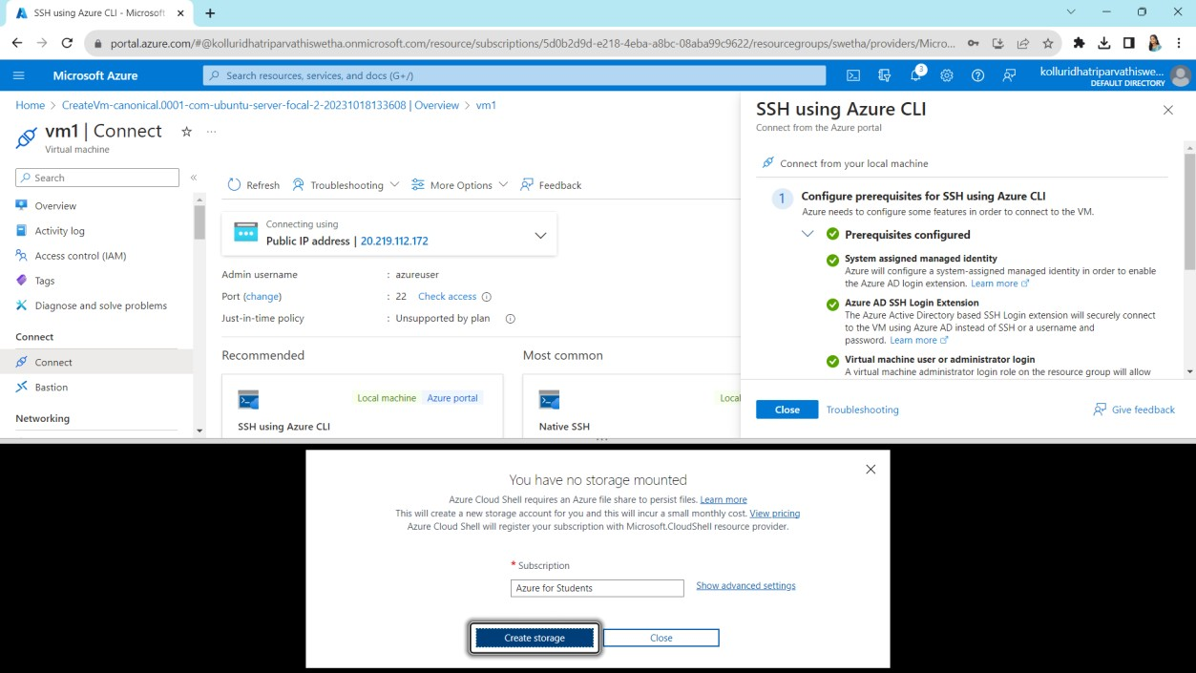
Click on bash which is on bottum
Click on create storage

Slide 9
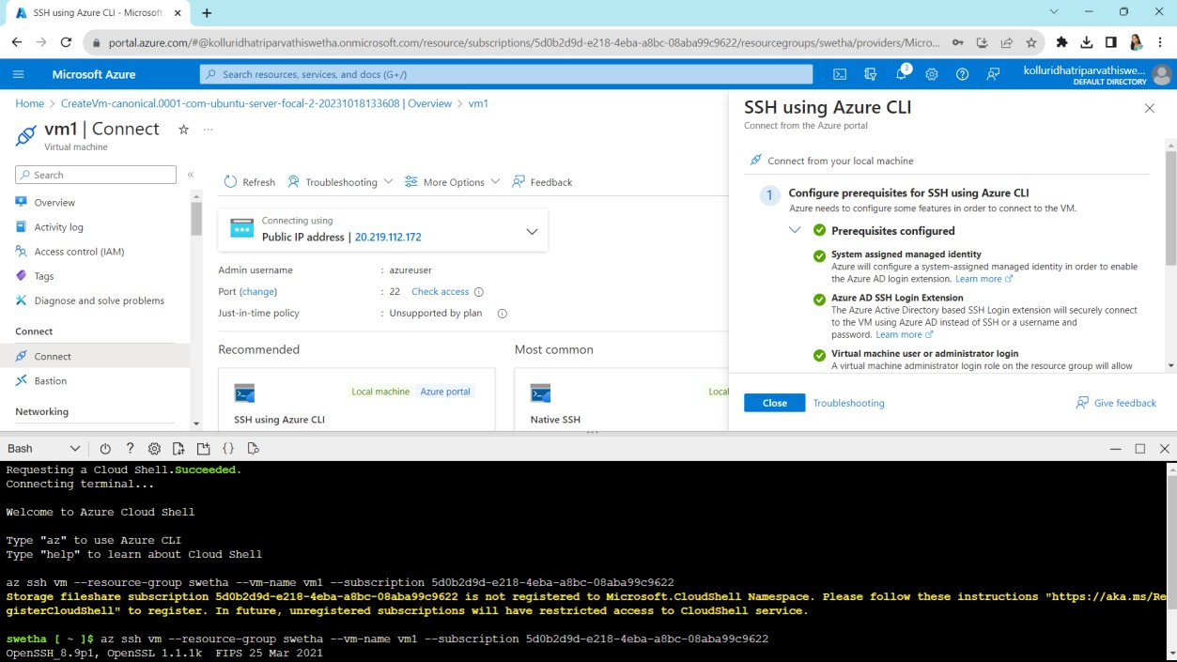
Finally established the remote connection

